Slide 1
Data Science Roadmap: A comprehensive guide to the field of data science its fundamental concepts and significance across different industries. By TOGUNDE, Azeez Adigun Data Science Student GOMYCODE

Slide 2
Presentation Outline
Introduction
Fundamental Concepts
Data Science Roadmap
Conclusion

Slide 3
Introduction
Data Science is a field that combines scientific methods, processes and systems to extract knowledge and insights from data.
It is about data gathering, analysis and decision making.
It is about finding patterns in data, through analysis, and making future predictions.
By using Data Science, companies are able to make:
Better decisions (whether to choose A or B)
Predictive analysis (what will happen next?)
Pattern discoveries (find pattern, or maybe hidden information in data)

Slide 4
Introduction
Application areas
Data Science is used in many industries in the world today as discussed below:
Transportation
1. For route planning: to discover the best routes to ship
2. To foresee delays for flight/ship/train etc. (through predictive analysis)
3. To find the best suited time to deliver goods.
Manufacturing
1. To create promotional offers.
2. To forecast the next years revenue for a company.
Healthcare
1. To analyze health benefit of training.
2. To predict the effect of a drug when used.

Slide 5
Introduction
Application areas
Politics
1. To predict who will win elections.
2. To predict the behavioral pattern of an individual when elected to a position.
Other areas include
1. Banking
2. Consultancy
3. Stock markets
4. E-commerce etc

Slide 6
Fundamental Concept
Data Analyst: A data analyst gathers, organizes and interprets statistical data using data analyst tools to provide meaningful results for clients to make important business decisions. He is also known as a business analyst.
Data Engineer: A data engineer designs, builds, integrates and maintains big data for analysis by data analyst and scientist. He is also responsible for preparing and managing data from multiple sources. He is also known as a data administrator and data architect
Data Scientist: A data scientist performs duties of a data analyst with advanced algorithms and statistics expertise and has the ability to build, train and use machine learning and deep learning models to understand data. Data scientists are also called data managers and statisticians.

Slide 7
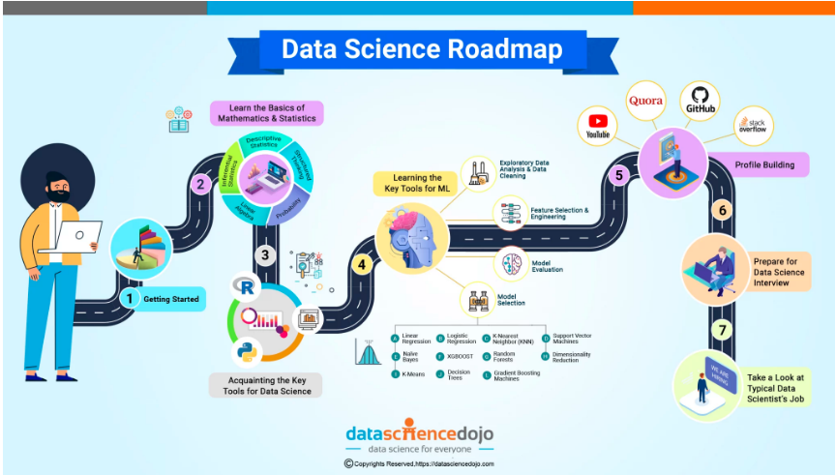
Data Science Roadmap
S
Fig 1: Data Science Roadmap

Slide 8
Data Science Roadmap
Step 1: Getting Started
This involves knowing what data science is all about and whether one is fit for it or not. This question can be answered through ones’ knowledge of R, Python or Excel.
Step 2: Learn the Basics of Mathematics and Statistics
This involves learning the fundamentals of mathematics and statistics. In this case, the area of focus include:
Descriptive Statistics
Probability
Inferential Statistics
Linear Algebra
Structured Thinking

Slide 9
Data Science Roadmap
Step 3: Acquainting with the Key Tools for Data Science
1. Python
This is one of the most popular and widely used programming languages and can be used for creating web applications, handling big data, rapid prototyping, and much more.
2. R
This is another popular language for programming in R which provides a free software environment for statistical computing.
3. Data Exploration & Visualization
For data analysis, learning data exploration & visualization is a must. Data exploration is the initial step of data analysis, while, data visualization is the graphical representation of the data itself. Both Python & R can be used for exploring & visualizing the data.

Slide 10
Data Science Roadmap
Step 4: Learning the Key Tools for Machine Learning (ML)
There are some basic and advanced machine learning tools that one needs to learn & adapt to. Some of the most important ones are listed below. These skills can be of immense value in ones overall data science roadmap:
1. Exploratory Data Analysis & Data Cleaning
2. Feature Selection & Engineering
3. Model Selection
4. Model Evaluation
Step 5: Profile Building
Building a profile on GitHub is an important task that every data scientist must complete. It is one of the most effective ways for a data scientist to gather all the code of the projects they have undertaken. It showcases ones code and projects undertaken and shows how long one have been practicing data science.

Slide 11
Data Science Roadmap
Step 6: Prepare for a Data Science Interview
You need to know all those key data science concepts that can help you ace your interviews. With these 101 Data Science Interview Questions. Answers, and Key Concepts you can prepare yourself for the interviews.
Step 7: Take a Look at a Typical Data Scientist’s Job
Reaching the end of your data science roadmap, you might want to get an idea of a typical data scientist’s job. It is always helpful to look at some job descriptions, showcase your skills, and stand out as the best candidate. If you think you are a good fit for it, you must get started right away!

Slide 12
Conclusion
It can be concluded that, instead of trying to learn all the skills required to be a data scientist endlessly, one should pick up a problem that inspires him or her.
Try to solve that problem using the data science skills and only pick up the skills necessary to solve that problem. As one solve more problems, one will learn more skills along the way and become a better data scientist.

Slide 13
References
w3schools.com/datascience/ds_introduction.asp
https://student.learn.gomycode.co
https://datasciencedojo.com/blog/data-science-roadmap/

